Slide 1
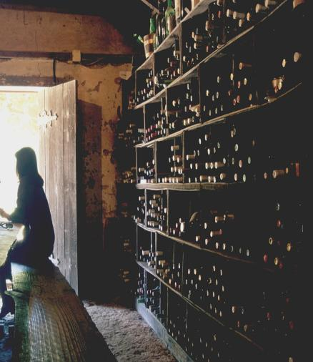
MBC 638 Final Project
White Wine Quality Analysis
Karan Bharadwaj
Thejaswini Ram
Nupur Dhatrak
Jeeshitha Badireddi

Slide 2

PART A
Dataset Description
Project Objectives
Descriptive and Statistical Analysis of Variables
Findings

Slide 3

About the Data
Description and Source of collection
The dataset is related to the white variant of the Portuguese "Vinho Verde" wine with 4898 observations and 12 variables in the raw dataset.
It contains several physicochemical and sensory parameters and a numerical variable grading the quality of each wine.
This dataset is a sample of an entire population of Portuguese "Vinho Verde" wines, and to add to this, it is a random sample. It represents a subset of the population of white wines that we want to understand through our analysis of this subset. In other words, it is representative of our target population.
Source of dataset: UCI Machine Learning Repository, Center for Machine Learning and Intelligent Systems

Slide 4
Through this dataset, we aim to:
Study the distribution of quality of the different wines in this dataset
Analyze the factors present in this dataset and compare that to the quality of wine depicted to see how these factors affect white wine quality
Research market statistics of Portuguese white wines and map our findings with that
Finally, we want to present a comprehensive analysis of this dataset along with real-world data to model the quality of Portuguese "Vinho Verde" wines. In the process of developing this project, we hope to study how different factors can play into affecting the quality of wine and even further affect economies based on this.
About the Data
Objectives of this project

Slide 5

Variable Description
About the Data
VARIABLES | DESCRIPTION
Fixed acidity (tartaric acid - g / dm^3) | most acids involved with wine or fixed or nonvolatile (do not evaporate readily)
volatile acidity (acetic acid - g / dm^3) | the amount of acetic acid in wine, which at too high of levels can lead to an unpleasant, vinegar taste
citric acid (g / dm^3) | found in small quantities, citric acid can add ‘freshness’ and flavor to wines
residual sugar (g / dm^3) | the amount of sugar remaining after fermentation stops, it’s rare to find wines with less than 1 gram/liter and wines with greater than 45 grams/liter are considered sweet
chlorides (sodium chloride - g / dm^3) | the amount of salt in the wine
free sulfur dioxide (mg / dm^3) | the free form of SO2 exists in equilibrium between molecular SO2 (as a dissolved gas) and bisulfite ion; it prevents microbial growth and the oxidation of wine
total sulfur dioxide (mg / dm^3) | amount of free and bound forms of S02; in low concentrations, SO2 is mostly undetectable in wine, but at free SO2 concentrations over 50 ppm, SO2 becomes evident in the nose and taste of wine
density (g / cm^3) | the density of wine compared to that of water depending on the percent alcohol and sugar content
pH | describes how acidic or basic a wine is on a scale from 0 (very acidic) to 14 (very basic); most wines are between 3-4 on the pH scale
sulphates (potassium sulphate - g / dm3) | a wine additive which can contribute to sulfur dioxide gas (S02) levels, which acts as an antimicrobial and antioxidant
alcohol (% by volume) | the percent alcohol content of the wine
quality (score between 0 and 10) | Output variable (based on sensory data): 12 - quality (score between 0 and 10)
.
R&Z Winery 2020

Slide 6
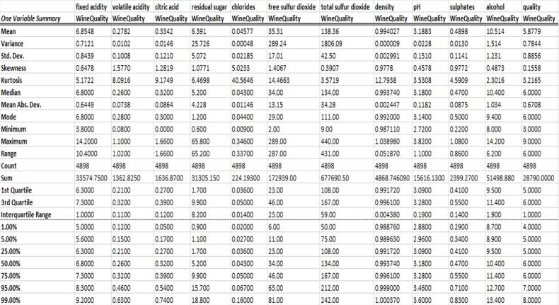
Summary Statistics
One Variable Summary
Mean residual sugar level is 6.39 g/l, but there is a sample of very sweet wine with 65.8 g/l (an outlier). Mean free sulfur dioxide is 35.3 ppm. Max value is 289 which is quite high as 75% is 46 ppm. PH of wine is within range from 2.7 till 3.8, mean 3.2. There is no basic wines in this dataset (no high pH levels). Alcohol: lightest wine is 8%, strongest is 14.2. Minimum quality mark is 3, mean 5.8, highest is 9

Slide 7
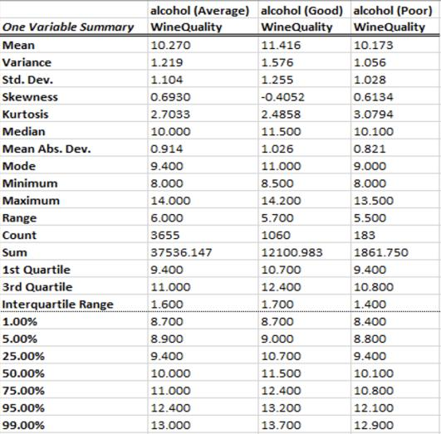
Summary Statistics
One Variable Summary
Wine quality Summary statistics based on alcohol percentage. When alcohol percentage is Good, the mean wine quality is higher than when Alcohol Percentage is Average or Poor.
R&Z Winery 2020

Slide 8
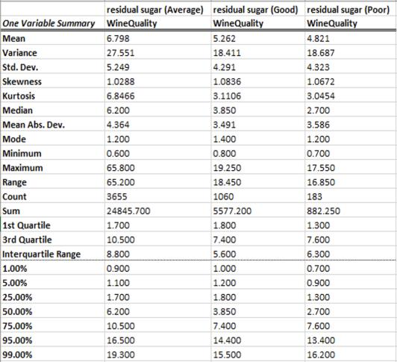
Summary Statistics
One Variable Summary
Wine quality summary statistics based on residual sugar type. When residual sugar levels are Average, the mean wine quality is higher than when sugar levels are Good or Poor.
R&Z Winery 2020

Slide 9
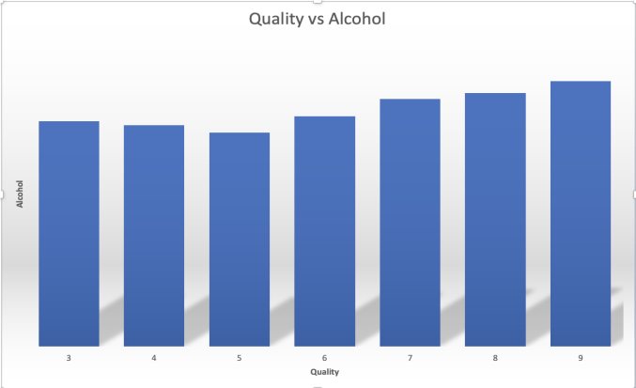
Descriptive Measures
Quantitative Data
.
It appears that most consumers prefer wines with a greater alcohol content, ones that make them feel wobbly! It's important to keep in mind that correlation does not always imply causation.
R&Z Winery 2020

Slide 10
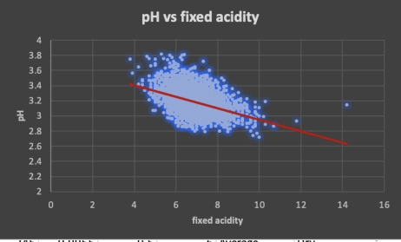
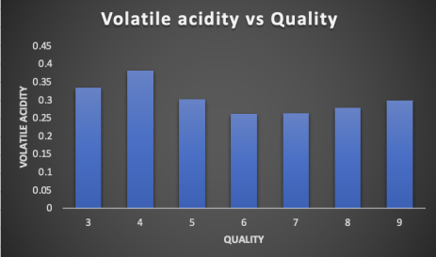
An exciting Correlation!
Quality VS pH and Volatile Acidity
This scatter-plot depicts how pH values change as fixed acidity levels change. We can see that when the level of fixed acidity rises, the pH drops. Doesn't it make sense? After all, a lower pH level indicates a greater acidity level.
Low volatile acidity levels are usually associated with higher quality. This makes sense because volatile acidity is a sign of deterioration and can generate unpleasant odors – something we know about from our domain.

Slide 11
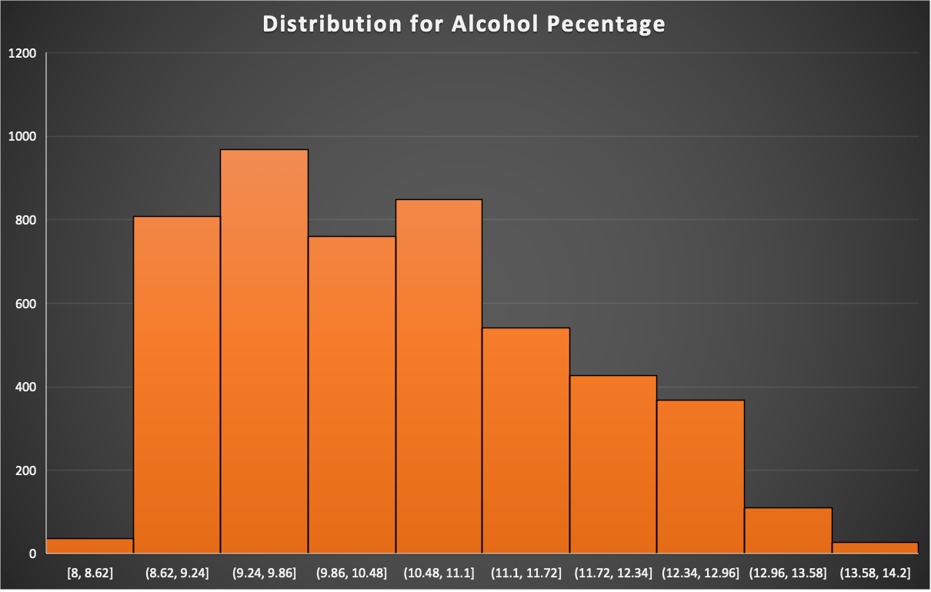
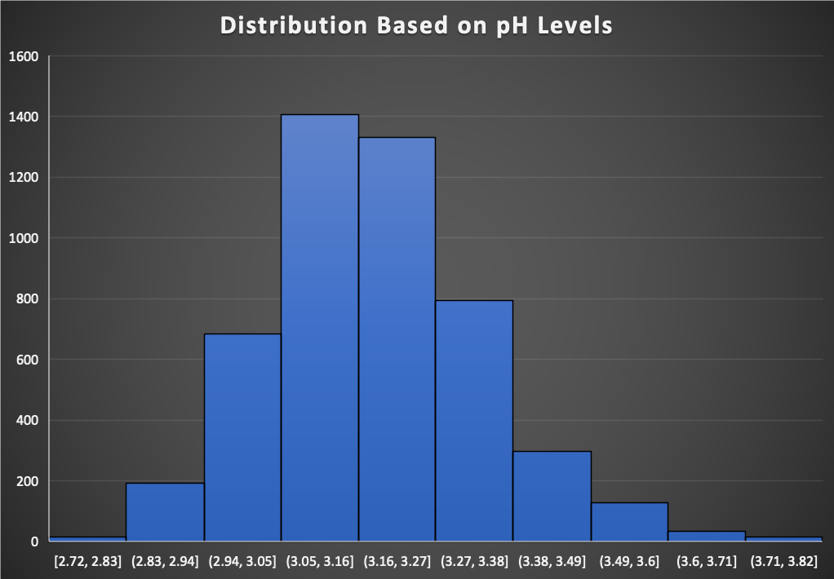
Descriptive Measures
Quantitative Data
The two distributions describe the percentage of alcohol and pH levels in white wine
The histogram (upper) represents the number of white wines as the alcohol percentage range
For ex. Maximum number of white wines have alcohol percentage in the range of 9.24% and 9.86% inclusive
The histogram (lower) represents the pH level ranges in white wines.
Like the distribution for alcohol percentage, highest number of white wines lie between the pH levels of 3.05 and 3.16 inclusive.
.
R&Z Winery 2020

Slide 12
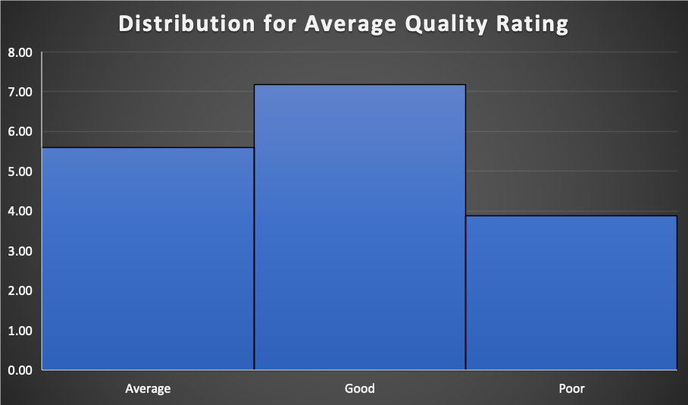
Descriptive Measures
Quantitative Data
.
The distribution here shows the average ratings for the white wines based on the quality viz. Poor, Average and Good
On an average, "Good" quality wines have a rating of 7.17
Similarly, "Average" quality wines have a rating of 5.60
While "Poor" quality wines have a rating of 3.89
R&Z Winery 2020

Slide 13
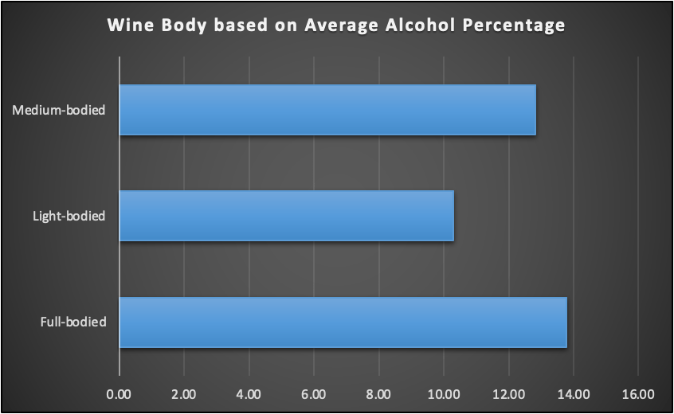
Descriptive Measures
Quantitative Data
.
The distribution here categorizes wines based on the average alcohol content into three types of wine bodies viz. "Medium-bodied", "Light-bodied" and "Full-bodied"
The average alcohol content in Medium-bodied wines is 12.81%
Similarly, the average alcohol content in Light-bodied wines is 10.28%
And the average alcohol content in Full-bodied wines is 13.77%
R&Z Winery 2020

Slide 14
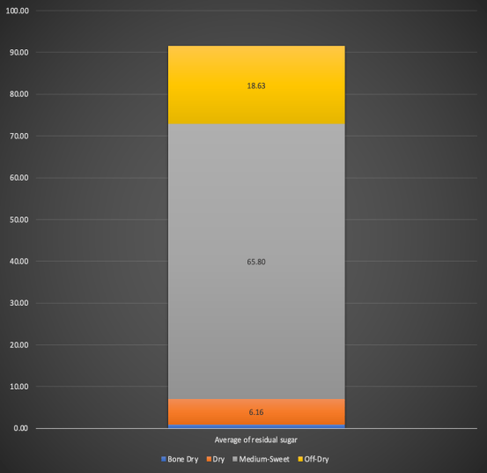
Descriptive Measures
Quantitative Data
The distribution here categorizes wines into "Bone Dry", "Dry", "Medium-Sweet" and "Off-Dry" based on the average content of the residual sugar
The average content of residual sugar in Bone Dry wines is 0.93 g/dm^3
The average content of residual sugar in Dry wines is 6.16 g/dm^3
The average content of residual sugar in Medium-Sweet wines is 65.80 g/dm^3
The average content of residual sugar in Off-Dry wines is 18.63 g/dm^3
.
fig. d
R&Z Winery 2020

Slide 15
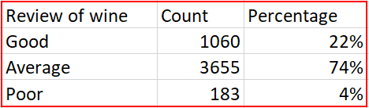
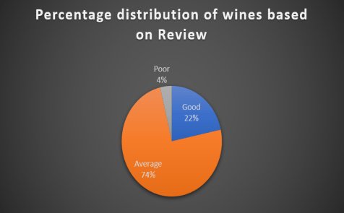
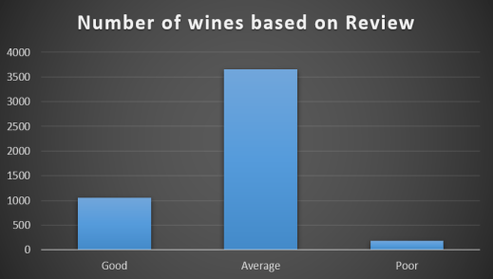
Descriptive Measures
Qualitative/Categorical Data – Review of wine
"review" is a qualitative variable developed by categorizing the observations based on the numerical variable "quality" as below:
Quality > 7 -> Good
Quality = 5 or 6 -> Average
Quality < 5 -> Poor
Numerical & Percentile distribution of observations based on wine quality:
Graphical representation I) percentile (left) b) count (right):
R&Z Winery 2020

Slide 16
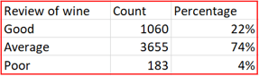
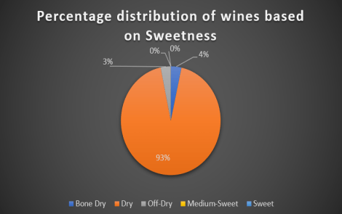
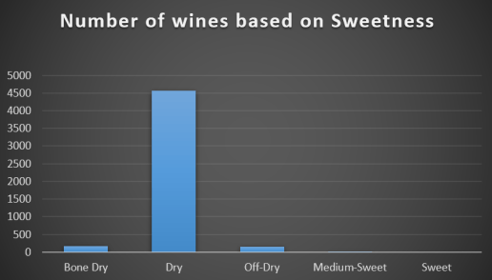
Descriptive Measures
Qualitative/Categorical Data – Sweetness of wine
"sweetness" is a qualitative variable developed by categorizing the observations based on the numerical variable "residual sugar" into: Bone Dry, Dry, Off-Dry, Medum-Sweet, Sweet
Numerical & Percentile distribution of observations based on residual sugar in wine:
Graphical representation I) percentile (left) b) count (right):
R&Z Winery 2020

Slide 17
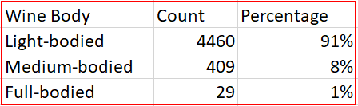
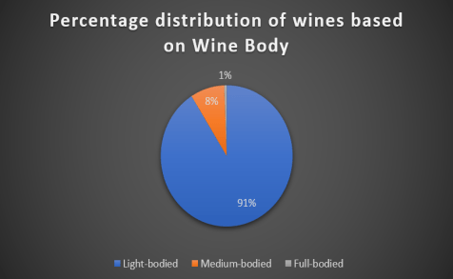
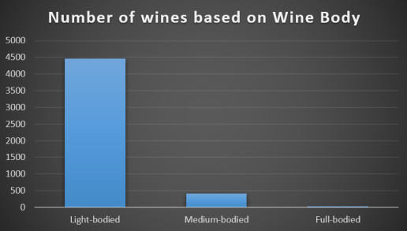
Descriptive Measures
Qualitative/Categorical Data – Wine Body
"wine body" is a qualitative variable developed by categorizing the observations based on the numerical variable "alcohol" into: Light-bodied, Medium-bodied, Full-bodied
Numerical & Percentile distribution of observations based on alcohol level in wine:
Graphical representation a) percentile (left) b) count (right):
R&Z Winery 2020

Slide 18

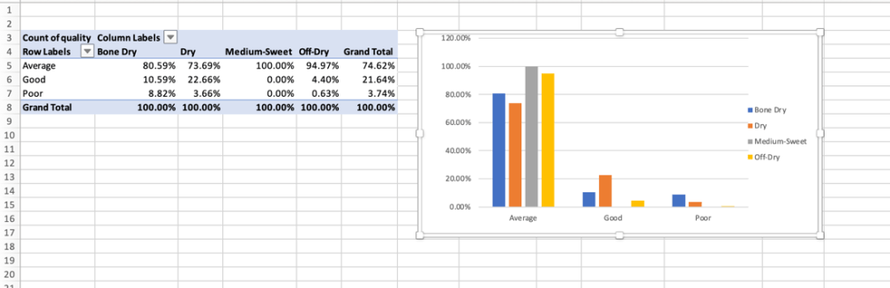
This Pivot Table/chart shows the distribution of quality ratings within each wine type based on sweetness. Interestingly, only about 10% of bone dry wines, 22% of dry wines and 4% of off-dry wines were rated “Good”. We then proceed to examine the same distribution but with “wine body”, which is based on ABV as a filter.
R&Z Winery 2020

Slide 19
Summary of PART A
Dataset population Analysis
There were several insights we gained based on our analysis of this sample. For example, consumers seem to prefer wines with higher alcohol content or in other words, these wines have greater quality. Most wines in this dataset seem to be light-bodied and dry with average quality.
To further classify our data appropriately, we produced the categorical variables "wine body", "review" and "sweetness" based on some of our numerical/categorical variables. We also inculcated information from the Web about these type of wines to further make sense of our dataset.
This analysis also further provides explanations of what each of the variables mean. This is especially because we can tie up the numerical values with the variable quality. What does total sulfur dioxide mean? What does residual sugar mean in terms of wine quality? How does quality differ with the composition of wine body?
We wanted the descriptive analysis form a strong basis for the next art of this project: regression analysis and predictions. We think that goal is achieved.
R&Z Winery 2020

Slide 20
PART B
Explanatory and dependent variables
Correlation Analysis
Multiple Regression Analysis
Interpretation of results
Evaluation of findings
Predictions
Business Use

Slide 21
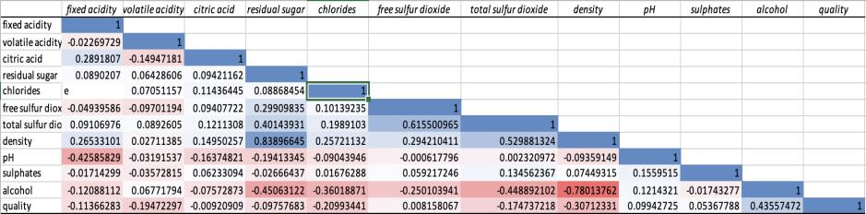
We are interested in building a regression model with quality as our dependent variable. We plan to employ a step-up approach to select predictors. We start with the variable having the highest correlation coefficient followed by the second highest and so on. We observe the variation in Adjusted R-Square at each step. We drop or retain the variables accordingly in our attempt to generate a multivariate linear regression model that produces the highest value of Adjusted R-Square.
Selection of independent variables for the multiple regression model – Table of Correlation Coefficients

Slide 22
1. Alcohol 2. Density 3. Chlorides 4. Volatile Acidity 5. Total Sulfur Dioxide 6. Fixed Acidity 7. pH 8. Sulphates 9. Citric Acid 10. Free Sulfur Dioxide
Selection of independent variables for the multiple regression model – Table of Correlation Coefficients
Order of independent variables inputted as referenced from the correlation table:

Slide 23
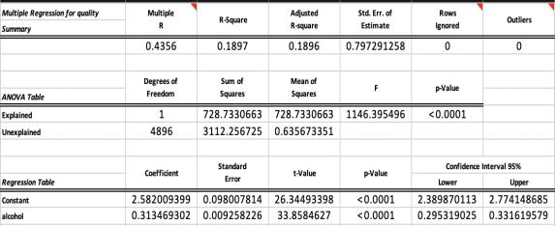
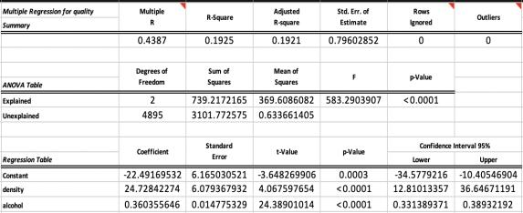
Multivariate Linear Regression – Step-Up Approach
We begin by selecting alcohol as x variable and quality as the y variable as this pair has the highest correlation coefficient.
When we add density into the model, we observe an increase in Adjusted R-Square. Hence, we retain it.
R&Z Winery 2020

Slide 24
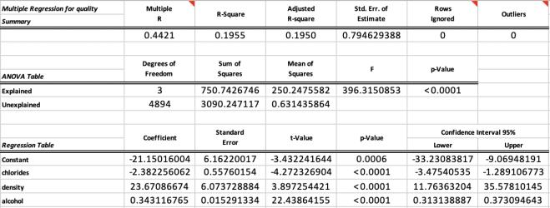
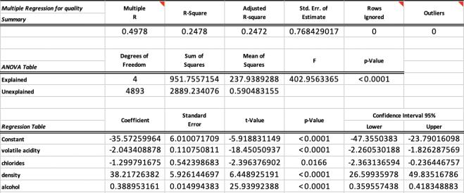
Multivariate Linear Regression – Step-Up Approach (contd.)
We add chlorides, Adjusted R-Square goes up, we retain it.
We next add Volatile Acidity into the model, Adjusted R-Square goes up, we retain it.
R&Z Winery 2020

Slide 25
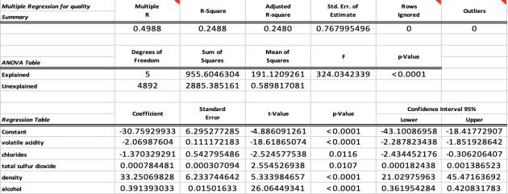
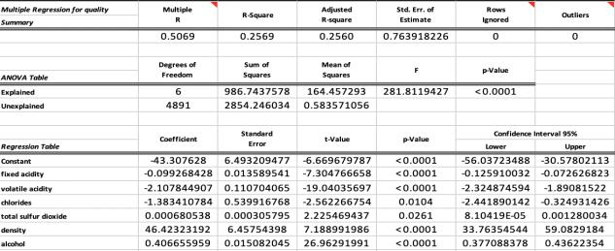
Multivariate Linear Regression – Step-Up Approach (contd.)
Subsequently, we add total sulfur dioxide, Adjusted R-Square goes up, we retain it.
Next we insert fixed acidity, Adjusted R-Square increases, we retain it.
R&Z Winery 2020

Slide 26
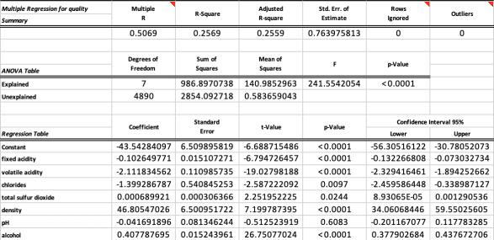
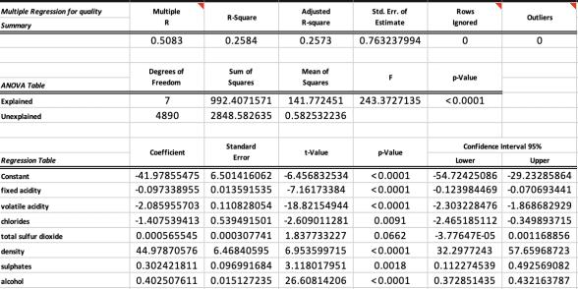
Multivariate Linear Regression – Step-Up Approach (contd.)
Next, we add pH into the model and we observe a decrease in adjusted R square value. Hence we DROP the variable.
Further, we add Sulphates into the model and observe an increase in adjusted R square. We retain it.
R&Z Winery 2020

Slide 27
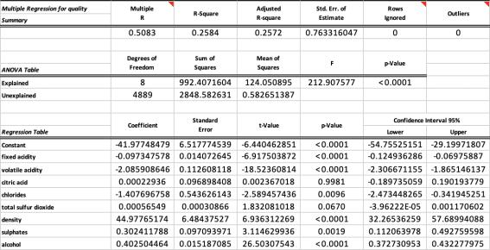
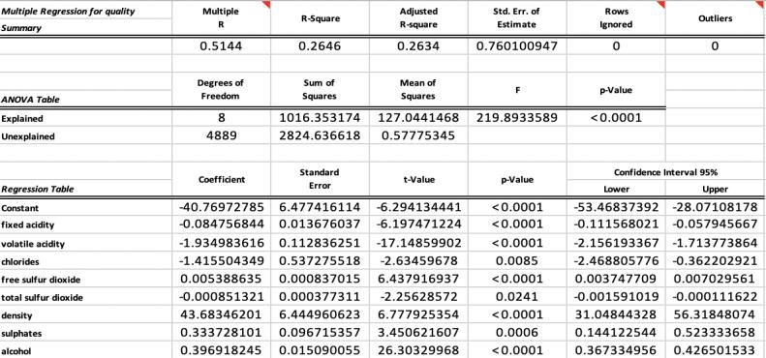
Multivariate Linear Regression – Step-Up Approach (contd.)
Similarly, we add citric acid and retain it.
Finally, we add free sulfur dioxide into the model and retain it.
R&Z Winery 2020

Slide 28

Multiple Regression Analysis – Interpretations and Evaluations
This is our final version of the multiple variable regression model which contains 8 predictors and 1 dependent variable, i.e., quality. Even though the Adjusted R- square value is quite modest, we believe all the predictors are statistically significant as they have low p-Values.

Slide 29

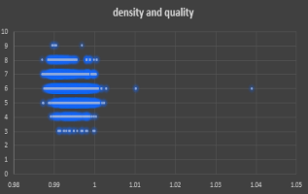
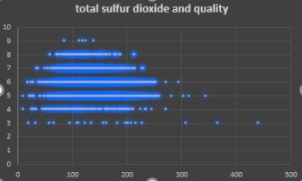
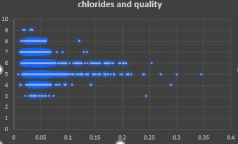
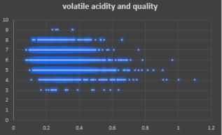
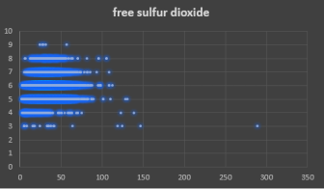
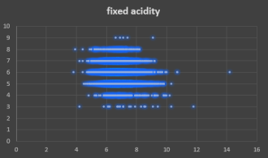
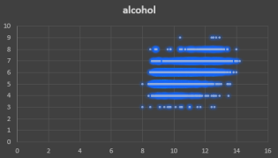
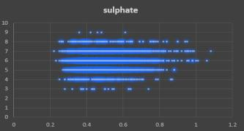
Correlation Analysis
Scatterplots

Slide 30
There are numerous questions we could answer based on our analysis however, if there was a wine company that hired us, we want to be able to give them the best advice to sell great wine. Some questions we would like to answer based on our choice of variables: We know a higher concentration volatile acidity creates unpleasant smells and this is assumed to impact quality but to what extent? Higher alcohol percentages, better wine, right? How strong is this effect? Sulfur Dioxide in higher levels becomes evident in smell and taste of wine but does this mean better quality? The saltiness of white wines is based on terroir which indicates final concentration and quality. How and how much? Based on market research, we know that low density wines have better quality. What about vinho verde wines?
Business Questions

Slide 31
Multiple Regression Analysis – Forecasting and Predictions
Numerical and Categorical predictors
The best Portuguese white wines seem to have high alcohol contents, high density, a good amount of free sulfur dioxide, and low acidity levels (both volatile and fixed). What does this implicate?
High levels of alcohol mean stronger wines, Added to this, wines that have flavors accentuating their taste benefit from more alcohol in their composition as it again accentuates the taste. So.......... heavy-bodied wines for the win!!!
In terms of free sulfur dioxide, quality is being impacted as higher levels of this prevents oxidation and microbial growth. It acts a component that safeguards the quality of wine.
Concentrated aromas on the nose and palate is because of the density of wines. More the concentration, better the quality.
Acidity of wines at higher concentrations can mean unpleasant taste smell. Any wine manufacturer would want to avoid that!
With all this said, one can use the regression analysis in this project to forecast the quality of a Portuguese vinho verde white wine. If it had X alcohol level and Y acidity levels and so on, what would be its quality?
Quality = -40.7697 + -0.0847 * fixed acidity + -1.9349 * volatile acidity + -1.4155 * chlorides + 0.0053 * free sulfur dioxide + -0.0008 * total sulfur dioxide + 43.6834 * density + 0.3337 * sulphates + 0.3969 *alcohol

Slide 32

Business Use
How is this useful in the real world? + Our Recommendations
This project aimed to analyze the physicochemical components of Portuguese white wines based on a dataset of observations to see how they affect quality using various statistical methods.
An important application of this project is aimed at wine manufacturing companies. By analyzing how quality measures up when compared with a wine's components, a manufacturer could potentially produce the best wine out there in terms of quality. In fact, studying the interactions of how different components at certain levels can mean something is also an interesting thought.
When one produces a high-quality wine, more consumers like it, and this means more revenue/profit. Of course, there are other aspects to this such as marketing, competitors etc., however, our project inferences can be combined with a consumer demographic analysis to enable companies to make profit out of their wine manufacturing business.
R&Z Winery 2020

Slide 33
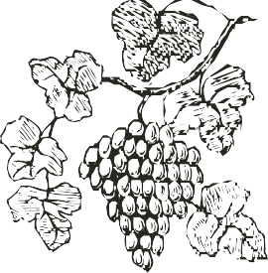
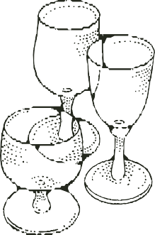

THANK YOU!

